Slide 1

ENERGY EFFICIENT 1-BIT APPROXIMATE FULL ADDERs using cntfet
Batch -1
Under the Guidance of Submitted by :-
Dr . M. Sarada G. Apurupa - 181FA05089
Professor P. Sai Krishna - 181FA05114
IV-ECE

Slide 2
CONTENTS
Objective
Introduction
Existing Approximate Adder Circuits
Proposed Approximate Adder Circuits
Applications:
4-bit Ripple Carry Adder Circuit
2*4 Multiplier
Results
Conclusion
References
Publications

Slide 3
Objectives
The objectives of energy efficient 1-bit approximate full adders using CNTFET are
To design the approximate full adder
To reduce the number of transistors
To reduce the power consumption and delay
To implement RCA and 2*4 multiplier using the proposed approximate adder

Slide 4
INTRODUCTION
Approximate Computing is used to trade off the strict computing correctness of conventional full adder for better performance and energy efficiency of the digital computer system.
Approximate adders allow operating in parallel for high speed and energy efficiency with an existing chance of incorrect results.
Approximate Adders are mainly used for Image processing, Audio, Video Processing, and Machine learning applications.
The Carbon Nanotube Field Effect Transistor (CNFET) is used widely in nanotechnologies in place of MOSFETs. These comprise of two types P- type CNFET and n-type CNFET.
The CNTFETs are one-atom-thick layer graphene tubes that are transformed into cylindrical pipes. As compared to MOSFETs switching speed is high for CNTFETs.

Slide 5
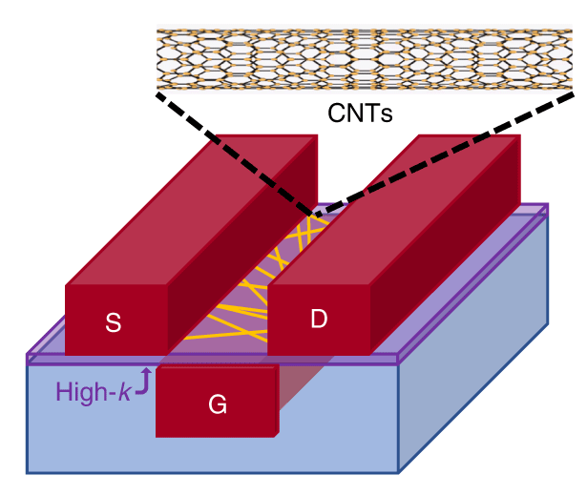
Cont..
Due to this factor, the Power dissipation is low for CNFET circuits than for MOSFET circuits. CNTFETs provide the opportunity to control the threshold voltage by changing the diameter of CNT, or chirality vector.
Carbon nanotubes are composed of tubular graphite plates that are based on the chirality vector C = ma₁ + na₂ where a₁ and a₂ are the unit vectors of the graphite plate, and the chirality (m, n) determines how the CNTs twist.
Fig.1: Structure CNTFET

Slide 6
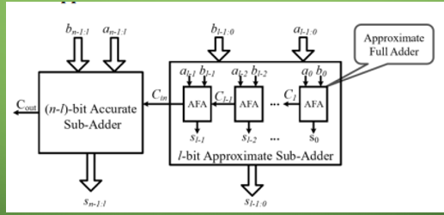
Cont..
Fig.2:Approximate Computing
6

Slide 7
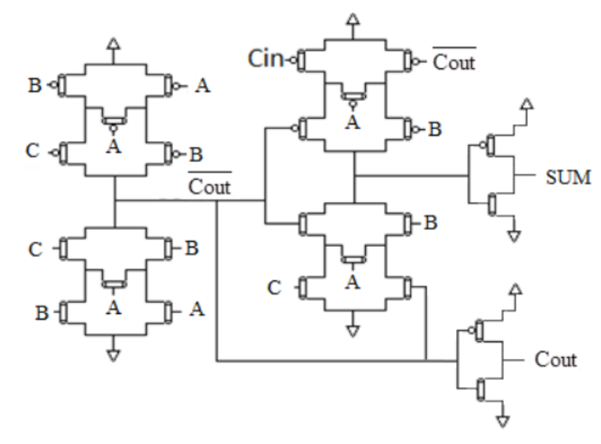
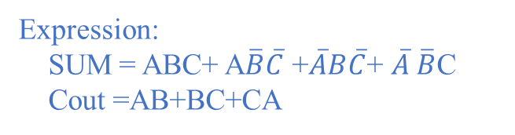
Exact Full Adder Circuit
Expression:
SUM = ABC+ A$\overline{B}\overline{C}$ +$\overline{A}B\overline{C}$+ $\overline{A} \overline{B}$C
Cout =AB+BC+CA
No. of transistors: 24
Truth table of Exact Full Adder
A | B | Cin | SUM | Cout
0 | 0 | 0 | 0 | 0
0 | 0 | 1 | 1 | 0
0 | 1 | 0 | 1 | 0
0 | 1 | 1 | 0 | 1
1 | 0 | 0 | 1 | 0
1 | 0 | 1 | 0 | 1
1 | 1 | 0 | 0 | 1
1 | 1 | 1 | 1 | 1
Fig.3: Exact Full Adder
[1] Ghorbani, Ali & Ghorbani, Ghazaleh. (2014). Energy Efficient Full Adder Cell Design With Using Carbon Nanotube Field Effect Transistors In 32 Nanometer Technology. International Journal of VLSI Design & Communication Systems. 5. 10.5121/vlsic.2014.5501.
7

Slide 8
Existing Approximate Adder Circuits
Approximate Adder 1
Truth Table for AA1
Vdd
Vdd
A | B | C | Sum | Carry
0 | 0 | 0 | 1 | 0
0 | 0 | 1 | 0 | 1
0 | 1 | 0 | 1 | 0
0 | 1 | 1 | 0 | 1
1 | 0 | 0 | 1 | 0
1 | 0 | 1 | 0 | 1
1 | 1 | 0 | 0 | 1
1 | 1 | 1 | 0 | 1
Vdd
A
Vdd
Vdd
B
C
A
Carry
Sum
C
B
GND
GND
GND
GND
GND
Fig.4: Approximate Adder-1
No. of transistors : 14
Expression:
Sum =~Carry
Carry =(A. B)+C
[2]:M. Ramasamy, G. Narmadha and S. Deivasigamani, “Carry based approximate full adder for low power approximate computing,” 7th International Conference on Smart Computing & Communications (ICSCC), pp. 1-4, 2019.

Slide 9
Approximate Adder 2
Vdd
Truth Table for AA2
Vdd
Vdd
A | B | C | Sum | Carry
0 | 0 | 0 | 1 | 0
0 | 0 | 1 | 1 | 0
0 | 1 | 0 | 1 | 0
0 | 1 | 1 | 0 | 1
1 | 0 | 0 | 0 | 0
1 | 0 | 1 | 0 | 1
1 | 1 | 0 | 0 | 1
1 | 1 | 1 | 0 | 1
B
Vdd
Vdd
C
A
B
Carry
Sum
A
C
GND
GND
GND
GND
GND
Fig.5: Approximate Adder-2
No. of transistors : 14
Expression:
Sum =~Carry
Carry =(B. C)+A
[2] M. Ramasamy, G. Narmadha and S. Deivasigamani, “Carry based approximate full adder for low power approximate computing,” 7th International Conference on Smart Computing & Communications (ICSCC), pp. 1-4, 2019.

Slide 10
Approximate Adder 3
No. of transistors : 18
Expression:
Sum =~Carry;
Carry =(A. B)^C
Truth Table for AA3
Vdd
A | B | C | Sum | Carry
0 | 0 | 0 | 1 | 0
0 | 0 | 1 | 0 | 1
0 | 1 | 0 | 1 | 0
0 | 1 | 1 | 0 | 1
1 | 0 | 0 | 1 | 0
1 | 0 | 1 | 0 | 1
1 | 1 | 0 | 0 | 1
1 | 1 | 1 | 1 | 0
GND
Carry
Sum
GND
GND
C
GND
Fig.6: Approximate Adder 3
[2] :M. Ramasamy, G. Narmadha and S. Deivasigamani, “Carry based approximate full adder for low power approximate computing,” 7th International Conference on Smart Computing & Communications (ICSCC), pp. 1-4, 2019.

Slide 11
Approximate Adder 4
No. of transistors : 14
Expression:
Sum =~Carry;
Carry =AB+BC+CA
Vdd
A
B
Truth Table for AA4
B
A | B | C | Sum | Carry
0 | 0 | 0 | 1 | 0
0 | 0 | 1 | 1 | 0
0 | 1 | 0 | 1 | 0
0 | 1 | 1 | 0 | 1
1 | 0 | 0 | 1 | 0
1 | 0 | 1 | 0 | 1
1 | 1 | 0 | 0 | 1
1 | 1 | 1 | 0 | 1
C
Vdd
C
A
Carry
Sum
A
B
C
GND
B
C
A
GND
GND
GND
Fig.7: Approximate Adder 4
[2] :M. Ramasamy, G. Narmadha and S. Deivasigamani, “Carry based approximate full adder for low power approximate computing,” 7th International Conference on Smart Computing & Communications (ICSCC), pp. 1-4, 2019.

Slide 12
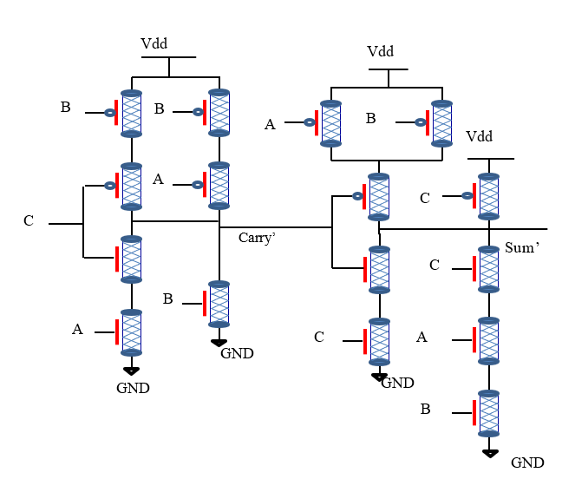
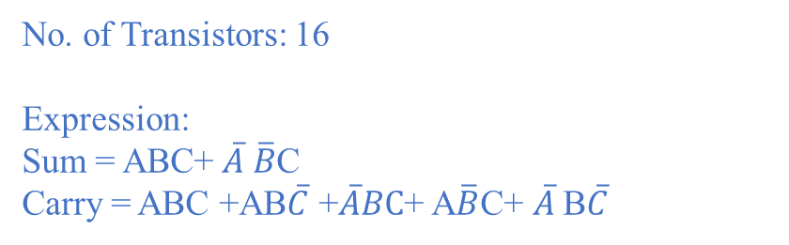
No. of Transistors: 16
Expression:
Sum = ABC+ $\overline{A} \overline{B}$C
Carry = ABC +AB$\overline{C}$ +$\overline{A}BC$+ A$\overline{B}$C+ $\overline{A}$B$\overline{C}$
Approximate Adder 5
Truth Table for AA5
A | B | C | Sum | Carry
0 | 0 | 0 | 0 | 0
0 | 0 | 1 | 1 | 0
0 | 1 | 0 | 0 | 1
0 | 1 | 1 | 0 | 1
1 | 0 | 0 | 0 | 0
1 | 0 | 1 | 0 | 1
1 | 1 | 0 | 0 | 1
1 | 1 | 1 | 1 | 1
Fig.8: Approximate Adder 5
[3] :V. Gupta, D. Mohapatra, A. Raghu Nathan, and K. Roy, “Low-power digital signal processing using approximate adders,” IEEE Trans. OnComputer-Aided Design of Integrated Circuits and Systems, vol. 32,no. 1, pp. 124–137, Jan. 2013.

Slide 13
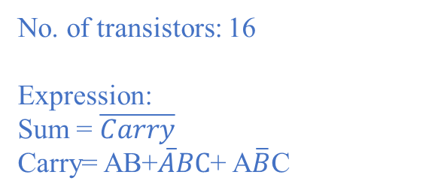
No. of transistors: 16
Expression:
Sum = $\overline{Carry}$
Carry= AB+$\overline{A}BC$+ A$\overline{B}$C
Approximate Adder 6
Vdd
A
B
B
Truth Table for AA6
Vdd
Vdd
A | B | C | Sum | Carry
0 | 0 | 0 | 1 | 0
0 | 0 | 1 | 1 | 0
0 | 1 | 0 | 1 | 0
0 | 1 | 1 | 0 | 1
1 | 0 | 0 | 1 | 0
1 | 0 | 1 | 0 | 1
1 | 1 | 0 | 0 | 1
1 | 1 | 1 | 0 | 1
A
Carry’
Sum
GND
GND
GND
Fig.9: Approximate Adder 6
[3] :V. Gupta, D. Mohapatra, A. Raghu Nathan, and K. Roy, “Low-power digital signal processing using approximate adders,” IEEE Trans. OnComputer-Aided Design of Integrated Circuits and Systems, vol. 32,no. 1, pp. 124–137, Jan. 2013.

Slide 14
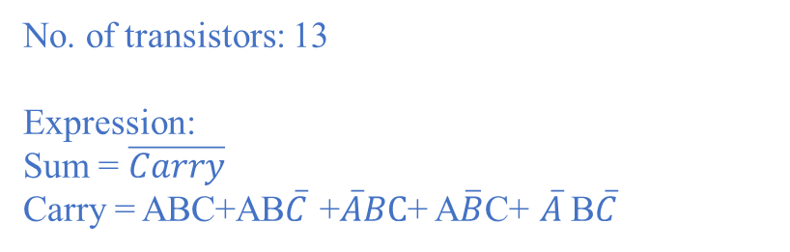
Approximate Adder 7
No. of transistors: 13
Expression:
Sum = $\overline{Carry}$
Carry = ABC+AB$\overline{C}$ +$\overline{A}BC$+ A$\overline{B}$C+ $\overline{A}$B$\overline{C}$
Vdd
B
Truth Table for AA7
B
A | B | C | Sum | Carry
0 | 0 | 0 | 1 | 0
0 | 0 | 1 | 1 | 0
0 | 1 | 0 | 0 | 1
0 | 1 | 1 | 0 | 1
1 | 0 | 0 | 1 | 0
1 | 0 | 1 | 0 | 1
1 | 1 | 0 | 0 | 1
1 | 1 | 1 | 0 | 1
Vdd
Vdd
A
C
Carry’
Sum
A
B
GND
GND
GND
Fig.10: Approximate Adder 7
[3] :V. Gupta, D. Mohapatra, A. Raghu Nathan, and K. Roy, “Low-power digital signal processing using approximate adders,” IEEE Trans. OnComputer-Aided Design of Integrated Circuits and Systems, vol. 32,no. 1, pp. 124–137, Jan. 2013.

Slide 15
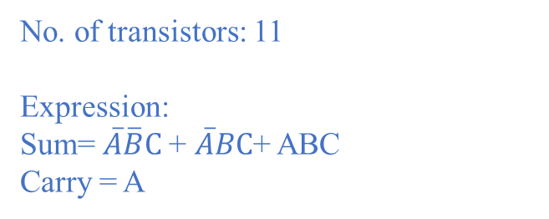
Approximate Adder 8
No. of transistors: 11
Expression:
Sum= $\overline{A}\overline{B}C$+ $\overline{A}BC$+ ABC
Carry = A
Vdd
A
B
Vdd
Truth Table for AA8
C
A | B | C | Sum | Carry
0 | 0 | 0 | 0 | 0
0 | 0 | 1 | 1 | 0
0 | 1 | 0 | 0 | 0
0 | 1 | 1 | 1 | 0
1 | 0 | 0 | 0 | 1
1 | 0 | 1 | 0 | 1
1 | 1 | 0 | 0 | 1
1 | 1 | 1 | 1 | 1
A
Carry’
Sum’
C
GND
C
A
GND
B
GND
Fig.11: Approximate Adder 8
[3] V. Gupta, D. Mohapatra, A. Raghu Nathan, and K. Roy, “Low-power digital signal processing using approximate adders,” IEEE Trans. OnComputer-Aided Design of Integrated Circuits and Systems, vol. 32,no. 1, pp. 124–137, Jan. 2013.

Slide 16
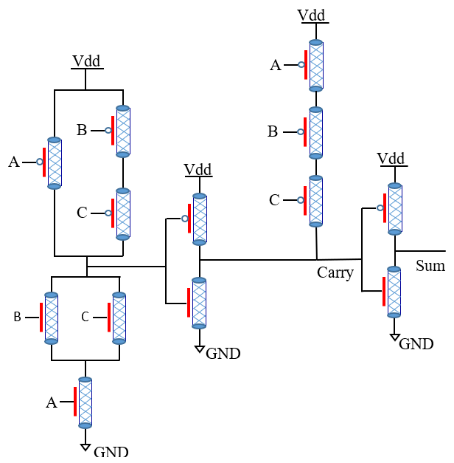
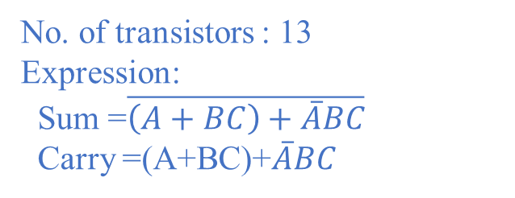
Approximate Adder 9
No. of transistors : 13
Expression:
Sum =$\overline{\left(A+BC\right)+\overline{A}BC}$
Carry =(A+BC)+$\overline{A}BC$
Truth Table for AA11
A | B | C | Sum | Carry
0 | 0 | 0 | 1 | 0
0 | 0 | 1 | 1 | 0
0 | 1 | 0 | 0 | 0
0 | 1 | 1 | 0 | 1
1 | 0 | 0 | 0 | 0
1 | 0 | 1 | 0 | 1
1 | 1 | 0 | 1 | 1
1 | 1 | 1 | 0 | 1
Fig.14: Approximate Adder 11
[4]: Bhargav, A.; Huynh, P. Design and Analysis of Low-Power and High Speed Approximate Adders Using CNFETs. Sensors 2021, 21, 8203

Slide 17
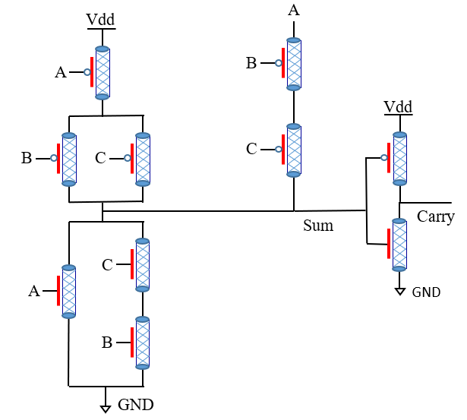
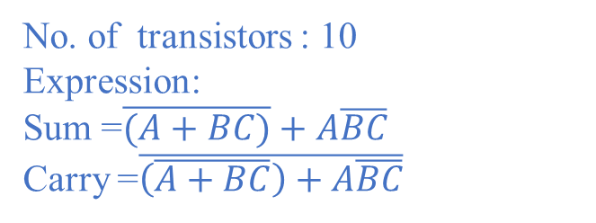
Approximate Adder 10
No. of transistors : 10
Expression:
Sum =$\overline{(A+BC)}+A\overline{BC}$
Carry =$\overline{\left(\overline{A+BC}\right)+A\overline{BC}}$
Truth Table for AA12
A | B | C | Sum | Carry
0 | 0 | 0 | 1 | 0
0 | 0 | 1 | 1 | 0
0 | 1 | 0 | 0 | 0
0 | 1 | 1 | 0 | 1
1 | 0 | 0 | 0 | 0
1 | 0 | 1 | 0 | 1
1 | 1 | 0 | 1 | 1
1 | 1 | 1 | 0 | 1
Fig.15: Approximate Adder 12
[4]: Bhargav, A.; Huynh, P. Design and Analysis of Low-Power and High Speed Approximate Adders Using CNFETs. Sensors 2021, 21, 8203

Slide 18
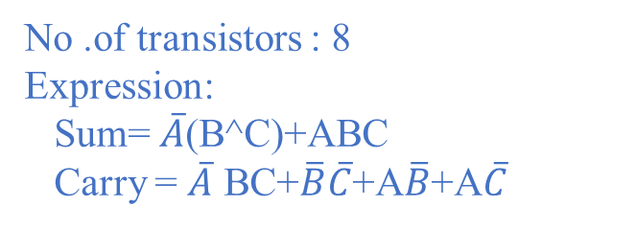
PROPOPSED APPROXIMATE ADDER 1
Carry
Truth Table for Proposed AA
Vdd
GND
Sum
A | B | C | Sum | Carry
0 | 0 | 0 | 0 | 1
0 | 0 | 1 | 1 | 0
0 | 1 | 0 | 1 | 0
0 | 1 | 1 | 0 | 1
1 | 0 | 0 | 0 | 1
1 | 0 | 1 | 0 | 1
1 | 1 | 0 | 0 | 1
1 | 1 | 1 | 1 | 0
C
B
A
GND
$\overline{B}$
A
B
Fig.18: Proposed AA3
No .of transistors : 8
Expression:
Sum= $\overline{A}$(B^C)+ABC
Carry = $\overline{A}$ BC+$\overline{B}\overline{C}$+A$\overline{B}$+A$\overline{C}$

Slide 19
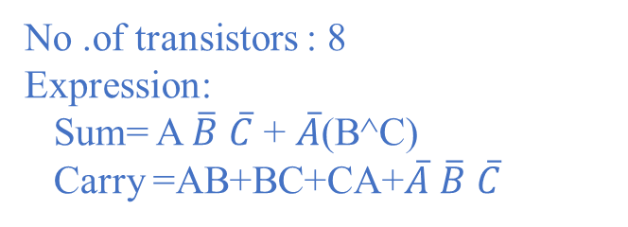
PROPOPSED APPROXIMATE ADDER 2
Carry
Vdd
GND
Truth Table for Proposed AA
Suma
A | B | C | Sum | Carry
0 | 0 | 0 | 0 | 1
0 | 0 | 1 | 1 | 0
0 | 1 | 0 | 1 | 0
0 | 1 | 1 | 0 | 1
1 | 0 | 0 | 1 | 0
1 | 0 | 1 | 0 | 1
1 | 1 | 0 | 0 | 1
1 | 1 | 1 | 0 | 1
C
B
A
$\overline{B}$
GND
A
B
Fig.17: Proposed AA2
No .of transistors : 8
Expression:
Sum= A $\overline{B}$ $\overline{C}$ + $\overline{A}$(B^C)
Carry =AB+BC+CA+$\overline{A}$ $\overline{B}$ $\overline{C}$

Slide 20

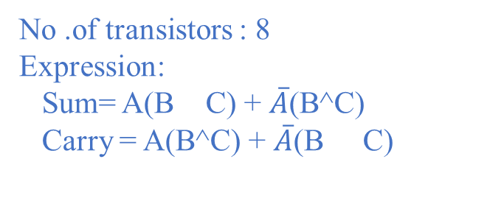


PROPOPSED APPROXIMATE ADDER 3
A
X
Truth Table for Proposed AA
A | B | C | Sum | Carry
0 | 0 | 0 | 0 | 1
0 | 0 | 1 | 1 | 0
0 | 1 | 0 | 1 | 0
0 | 1 | 1 | 0 | 1
1 | 0 | 0 | 1 | 0
1 | 0 | 1 | 0 | 1
1 | 1 | 0 | 0 | 1
1 | 1 | 1 | 1 | 0
B
B
C
C
X
$\overline{X}$
Sum
Carry
B
B
C
C
$$\overline{A}$$
$$\overline{X}$$
Fig.16: Proposed AA
No .of transistors : 8
Expression:
Sum= A(B C) + $\overline{A}$(B^C)
Carry = A(B^C) + $\overline{A}$(B C)
.
.

Slide 21
Table 1. Summary of Approximate Adders
S.No | Approximate Adder | No. of Transistors | No. of Errors |  | Technology used
 |  |  | Sum | Carry
1 | Exact Adder | 24 | 0 | 0 | CNTFET32nm
2 | AA1 | 14 | 3 | 1 | CNTFET32nm
3 | AA2 | 14 | 3 | 0 | CNTFET32nm
4 | AA3 | 18 | 2 | 2 | CNTFET32nm
5 | AA4 | 14 | 2 | 0 | CNTFET32nm
6 | AA5 | 16 | 2 | 1 | CNTFET32nm
7 | AA6 | 16 | 2 | 0 | CNTFET32nm
8 | AA7 | 13 | 3 | 1 | CNTFET32nm
9 | AA8 | 11 | 3 | 2 | CNTFET32nm
10 | AA9 | 13 | 2 | 0 | CNTFET32nm
11 | AA10 | 10 | 2 | 0 | CNTFET32nm
12 | Proposed AA1 | 8 | 1 | 3 | CNTFET32nm
13 | Proposed AA2 | 8 | 0 | 2 | CNTFET32nm
14 | Proposed AA3 | 8 | 1 | 1 | CNTFET32nm
21

Slide 22
Simulation Results of Approximate Adders
e approximate
Table 2. Transistor count, Delay, Power and PDP of AA
S. No. | Adders | No. of Transistors | Delay(ns) | Power(uw) | PDP(fJ)
1 | AA1 | 14 | 1.005 | 0.1175 | 0.1180
2 | AA2 | 14 | 1.498 | 0.1569 | 0.2350
3 | AA3 | 18 | 1.006 | 9.759 | 9.8175
4 | AA4 | 14 | 1.005 | 0.1253 | 0.1261
5 | AA5 | 16 | 1.002 | 0.1244 | 0.1246
6 | AA6 | 16 | 1.006 | 0.1218 | 0.1225
7 | AA7 | 13 | 0.996 | 0.1165 | 0.1160
8 | AA8 | 11 | 1.504 | 0.1589 | 0.2389
9 | AA9 | 13 | 1.004 | 1.447 | 1.4527
10 | AA10 | 10 | 1.497 | 1.571 | 2.3517
11 | Proposed AA1 | 8 | 0.996 | 0.1339 | 0.1336
12 | Proposed AA2 | 8 | 1.495 | 0.1239 | 0.1852
13 | Proposed AA3 | 8 | 1.499 | 0.0648 | 0.0971

Slide 23
4-Bit Ripple Carry Adder
The circuit diagram of 4-bit ripple carry adder is shown below
B3
A3
B2
A2
B1
A1
B0
A0
EXACT
FA1
EXACT
FA0
PROPOSED
AA1
PROPOSED
AA0
Carry
C0
C3
C2
C1
Sum3
Sum2
Sum1
Sum0
Fig.18: 4-bit ripple carry adder
[5] W. Yang, L. Wang and K. Li, "An Approximate Adder Design Based on Inexact Full Adders," 2021 IEEE 15th International Conference on Anti-counterfeiting, Security, and Identification (ASID), 2021, pp. 154-158, doi: 10.1109/ASID52932.2021.9651713.

Slide 24
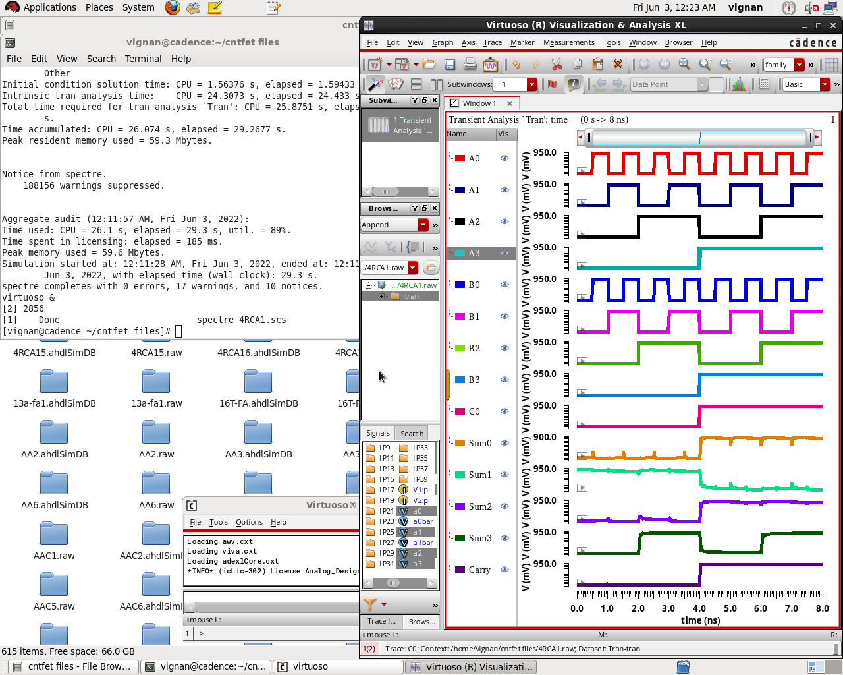
Output Waveform of 4-bit Approx. RCA
The following figure shows the transient response of proposed AA3 when it is implemented in 4-bit RCA
Fig.19: Transient response of 4-bit Approx. RCA

Slide 25
Simulation Results of Approx. RCA
Table 3. Transistor count, Delay, Power and PDP of Approx. RCA
S.No | RCA | Using AA# | No.of Transistors | Delay(ns) | Power(nw) | PDP(fJ)
1 | RCA1 | AA1 | 48 | 4.00517 | 364.0 | 1.45788
2 | RCA2 | AA2 | 48 | 4.00517 | 452.6 | 1.81273
3 | RCA3 | AA3 | 56 | 4.00517 | 16630 | 0.66605
4 | RCA4 | AA4 | 52 | 4.00517 | 2380 | 9.24393
5 | RCA5 | AA5 | 60 | 4.00517 | 445.2 | 1.78310
6 | RCA6 | AA6 | 52 | 4.00517 | 377.8 | 1.51315
7 | RCA7 | AA7 | 46 | 4.00517 | 295.2 | 1.18232
8 | RCA8 | AA8 | 50 | 4.00517 | 415.4 | 1.66374
9 | RCA9 | AA9 | 54 | 4.00517 | 483.3 | 1.93770
10 | RCA10 | AA10 | 40 | 4.00517 | 232.7 | 0.93200
11 | RCA11 | Proposed AA1 | 40 | 4.00517 | 211.4 | 0.84669
12 | RCA12 | Proposed AA2 | 40 | 4.00517 | 318.0 | 1.27364
13 | RCA13 | Proposed AA3 | 40 | 4.00517 | 169.4 | 0.67847

Slide 26
2*4 Multiplier
The 2*4 multiplier has 6 inputs named a0,a1,a2,a3,b0 and b1 and has 6 outputs R0 to R7. The MA2 block is a combination of multiplier, full adder and sum block. MA1 block consists of multiplier, half adder and sum block. The outputs R2 and R3 are the outputs of the approximate adders.
a₃
a₂
a₁
a₀
M
M
M
M
R0
b₀
MA1
MA2
MA2
MA2
R1
b₁
FA
FA
AFA
AFA
R2
R5
R4
R3
Fig 20. Block diagram of 2*4 Approx. Multiplier
[6] Rahmati, Saeed & Farshidi, E. & Ganji, Jabbar. (2021). Low energy and area efficient quaternary multiplier with carbon nanotube field effect transistors. ETRI Journal. 43. 10.4218/etrij.2020-0045.

Slide 27
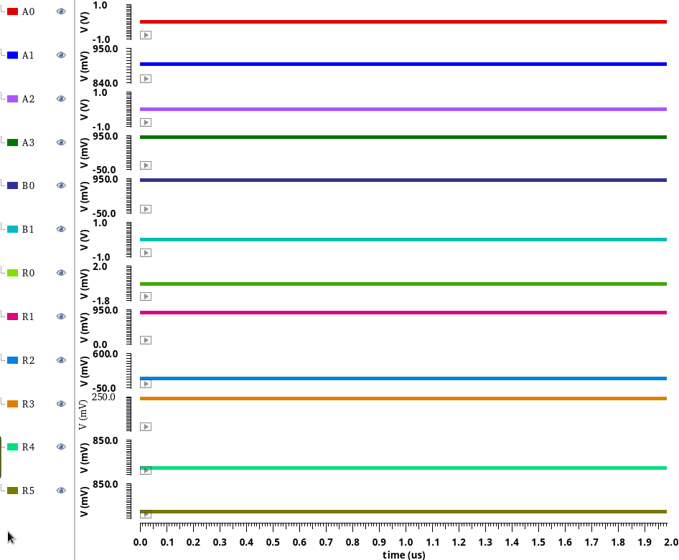
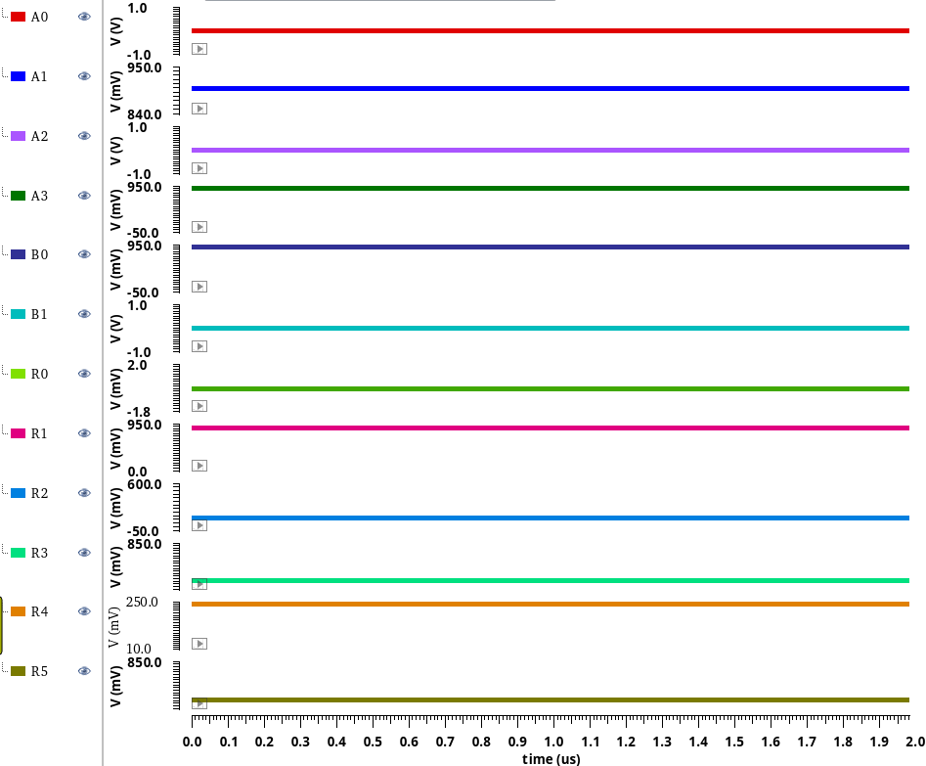
Output Waveforms of 2*4 Multiplier
Fig 22. Transient responses of Exact and Approximate Multiplier

Slide 28
Simulation Results of Approx. Multiplier
Table 4. Error count, Delay, Power and PDP of Approx. Multiplier
S.No | Multiplier | Using AA# | No. of Errors |  | Delay(uS) | Power(uW) | PDP(nW)
 |  |  | Sum | Carry
1 | Approx.Multiplier1 | AA1 | 3 | 1 | 2.00650 | 128.1 | 0.257032
2 | Approx.Multiplier2 | AA2 | 3 | 0 | 2.00355 | 140.3 | 0.281098
3 | Approx.Multiplier3 | AA3 | 2 | 2 | 2.00681 | 128.6 | 0.258075
4 | Approx.Multiplier4 | AA4 | 2 | 0 | 2.00665 | 131.7 | 0.264275
5 | Approx.Multiplier5 | AA5 | 2 | 1 | 2.00667 | 134.7 | 0.270299
6 | Approx.Multiplier6 | AA6 | 2 | 0 | 2.00619 | 138.4 | 0.277656
7 | Approx.Multiplier7 | AA7 | 3 | 1 | 2.00670 | 134.8 | 0.270503
8 | Approx.Multiplier8 | AA8 | 3 | 2 | 2.00660 | 128.8 | 0.258450
9 | Approx.Multiplier9 | AA9 | 2 | 0 | 2.00682 | 129.6 | 0.260084
10 | Approx.Multiplier10 | AA10 | 2 | 0 | 2.00350 | 131 | 0.262850
11 | Approx.Multiplier11 | Proposed AA1 | 1 | 3 | 2.05250 | 135.4 | 0.277908
12 | Approx.Multiplier12 | Proposed AA2 | 1 | 1 | 2.00355 | 135.7 | 0.271883
13 | Approx.Multiplier13 | Proposed AA3 | 0 | 2 | 2.00355 | 130 | 0.260461

Slide 29
CONCLUSION
Three approximate full adders are designed with less number of transistors compared to the existing circuits. The proposed AA1 has less delay and proposed AA3 has low power dissipation and has less PDP. By comparing all the proposed approximate adders, the proposed AA3 is the most energy efficient circuit. So, proposed AA3 is used to implement the applications 4-bit RCA and 2*4 multiplier.

Slide 30
PUBLICATIONS
Submitted a Springer conference paper named “Energy-Efficient Approximate Adders Using CNTFET” to International Conference on Microelectronics Electromagnetics and Telecommunications (ICMEET-2022) conducted by Sri Vishnu Engineering College for Women’s, Bhimavaram.
A Journal Paper “Low Power and Energy Efficient Approximate Full Adders for RCA and Multiplier Applications” has to be Submitted.

Slide 31
References
[1] Bhargav, A.; Huynh, P. Design and Analysis of Low-Power and High Speed Approximate Adders Using CNFETs. Sensors 2021, 21, 8203
[2] W. Yang, L. Wang and K. Li, "An Approximate Adder Design Based on Inexact Full Adders," 2021 IEEE 15th International Conference on Anti-counterfeiting, Security, and Identification (ASID), 2021, pp. 154-158, doi: 10.1109/ASID52932.2021.9651713.
[3] G. Ferreira, P. T. L. Pereira, G. Paim, E. Costa and S. Bampi, "A Power-Efficient FFT Hardware Architecture Exploiting Approximate Adders," 2021 IEEE 12th Latin America Symposium on Circuits and System (LASCAS), 2021, pp. 1-4, doi: 10.1109/LASCAS51355.2021.9667154.
[4] W. Yang, L. Wang and K. Li, "An Approximate Adder Design Based on Inexact Full Adders," 2021 IEEE 15th International Conference on Anti-counterfeiting, Security, and Identification (ASID), 2021, pp. 154-158, doi: 10.1109/ASID52932.2021.9651713.
[5] Zahoor, Furqan, Fawnizu A. Hussin, Farooq A. Khanday, Mohamad R. Ahmad, Illani Mohd Nawi, Chia Y. Ooi, and Fakhrul Z. Rokhani. 2021. "Carbon Nanotube Field Effect Transistor (CNTFET) and Resistive Random Access Memory (RRAM) Based Ternary Combinational Logic Circuits" Electronics 10, no. 1: 79.
[6] Y. Shanmugam, S. Chandran, C. Rohith and R. Silambarasan, "Design and Analysis of Approximate Adders Using Multiplexer," 2021 7th International Conference on Advanced Computing and Communication Systems (ICACCS), 2021, pp. 977-980, doi: 10.1109/ICACCS51430.2021.9441853.

Slide 32
Contd…
[7] Rahmati, Saeed & Farshidi, E. & Ganji, Jabbar. (2021). Low energy and area efficient quaternary multiplier with carbon nanotube field effect transistors. ETRI Journal. 43. 10.4218/etrij.2020-0045.
[8] M. Ramasamy, G. Narmadha and S. Deivasigamani, “Carry based approximate full adder for low power approximate computing,” 7th International Conference on Smart Computing & Communications (ICSCC), pp. 1-4, 2019.
[9] Ghorbani, Ali & Ghorbani, Ghazaleh. (2014). Energy Efficient Full Adder Cell Design With Using Carbon Nanotube Field Effect Transistors In 32 Nanometer Technology. International Journal of VLSI Design & Communication Systems. 5. 10.5121/vlsic.2014.5501.
[10] V. Gupta, D. Mohapatra, A. Raghu Nathan, and K. Roy, “Low-power digital signal processing using approximate adders,” IEEE Trans. OnComputer-Aided Design of Integrated Circuits and Systems, vol. 32,no. 1, pp. 124–137, Jan. 2013.
[11] V. Gupta, D. Mohapatra, S. P. Park, A. Raghunathan and K. Roy, “IMPACT: IMPrecise adders for low-power approximate computing,” IEEE/ACM International Symposium on Low Power Electronics and Design, Fukuoka, 2011, pp. 4

Slide 33


